Slide 1
Introduction to the
Cooperative Patent Classification (CPC) EPO and USPTO bi-lateral classification system
Presentation to the
Biotechnology/Chemical/Pharmaceutical Customer Partnership
February 2012

Slide 2
Objectives
By the end of this overview, you should understand
General features of the Cooperative Patent Classification (CPC) System
Why the USPTO is pursuing this initiative
Draft CPC timeline
General look and feel of CPC

Slide 3
Objectives
General features of Cooperative Patent Classification System (CPC)
Why the USPTO is pursuing this initiative
Draft CPC timeline
General look and feel of CPC
3

Slide 4
General Features of CPC
CPC is a joint USPTO/EPO classification system
CPC will be kept up to date
Ability to search a unified classification system
Reduces searching redundancy by providing a comprehensive patent document database
Merges PGPub and U.S. Patent databases
Patent documents classified by patent family
Permits search of foreign language document collection
Seamless integration of CPC symbols into current examination search tools
US and EP patent documents are already classified in ECLA and this backfile will be used as a basis for CPC
4
Notes:
4

Slide 5
General Features of CPC
Ability to search a unified classification system (Continued)
More refined breakdowns in many art areas yield more focused results
155,000 breakdowns in USPC vs. 200,000 breakdowns in CPC, initially
Collaborative maintenance of CPC Classification
EPO and USPTO will jointly undertake revision (reclassification) projects
EPO and USPTO will work together with our counterparts
More frequent and timely updates
Greater examiner involvement in revision projects
5
Notes:
5

Slide 6
Objectives
General features of Cooperative Patent Classification System (CPC)
Why the USPTO is pursuing this initiative
Draft CPC timeline
General look and feel of CPC
6
Notes:
6

Slide 7
Major Intellectual Property Offices and Patent Classification Systems
IPC Based Classification Systems Non-IPC based Classification Systems
European Patent Office (EPO)
Japan Patent Office (JPO)
United States Patent and Trademark Office (USPTO)
State Intellectual Property Office of China (SIPO)
World Intellectual Property Office (WIPO)
Korean Intellectual Property Office (KIPO)
7
Notes:
7

Slide 8
Comparison of Patent Classification Systems
USPC
IPC
ECLA
FI
CPC
Documents classified into system by
USPTO
IPC Union Members (61)
EPO, member states
Japan Patent Office
USPTO/EPO
Relationship to IPC
None
----
ECLA is an extension of IPC
FI is an extension of IPC
CPC is an extension of IPC
Classification
2 Standards for Classification*
Invention Information
Invention Information
Invention Information
Invention Information
Rules for classification
U.S. Classification Guidelines
IPC Guide
IPC Guide
+ Art Specific Rules
IPC Guide
+
Deep Indexing with F-Terms
IPC Guide
+
Art Specific Rules
Number of Subdivisions
150,000
69,000
145,000
180,000
200,000
*
PG Publication – Invention Information (i.e., Disclosed Invention or Inventive Concept)
Routing/Docketing & U.S. Patent Grant – Claim Scope
8
Notes:
8

Slide 9
Why the USPTO is pursuing this initiative
Provides the examination corps and stakeholders with:
International classification system based on International Patent Classification (IPC) standards
More comprehensive access to prior art
A classification scheme/system that is adaptive and more actively maintained
A single classification symbol set for all USPTO and EPO documents
9
Notes:
9

Slide 10
Why the USPTO is pursuing this initiative
Aligns with USPTO strategic goals
Implement IPC-based classification system at USPTO
Accelerate classification harmonization efforts with other major IP offices
Promote resource sharing
Improves global harmonization for examination and search
Classification is the foundation for all global harmonization efforts
Increases document coverage for classified search
A single classification search yields results from the USPTO, EPO and EPO member states
Note: USPTO is currently the only major IP office not using an IPC-based primary classification system
10
Notes:
10

Slide 11
Objectives
General features of Cooperative Patent Classification System (CPC)
Why the USPTO is pursuing this initiative
Draft CPC timeline
General look and feel of CPC
11
Notes:
11

Slide 12
High Level CPC Time Line
CPC Milestone | Timeframe
Introduction to CPC for all examiners. | 2012
Develop and deliver detailed examiner training in concert with EPO. | 2012-2014
Contractor applies CPC symbols to PGPUB pipeline documents. | January 1, 2013
USPC and CPC symbols will be searchable in EAST/WEST, while routing remains based on USPC. | 2013
CPC symbols will propagate from PGPUB to Grants | 2013
Examiners will begin to add CPC symbols as needed on issued applications, with voluntary search capability of CPC symbols in EAST/WEST. | 2013-2014
Final stage of CPC implementation. | 2015
12
12
Notes:
12

Slide 13
Objectives
General features of Cooperative Patent Classification System (CPC)
Why the USPTO is pursuing this initiative
Draft CPC timeline
General look and feel of CPC
13
Notes:
13

Slide 14
CPC Sections
► Sections: 8 Sections
14

Slide 15
Format of CPC Symbols
A23G 9/0202
► complete group symbol; consists of different components
A Section (A, B, ... H)
A23 Class (any 2 digits)
A23G Subclass (any letter)
A23G9/00 Main Group
A23G 9/0202 Subgroup
Note:
Documents are classified with main group and/or subgroup symbols
15
Notes:
15

Slide 16
Nomenclature:
CPC Symbols
Example of a CPC classification symbol
C
Section
07
Class
D
Subclass
203/00
or
203/0214
Group
Main Group (always /00)
Subgroup
16
Notes:
16

Slide 17
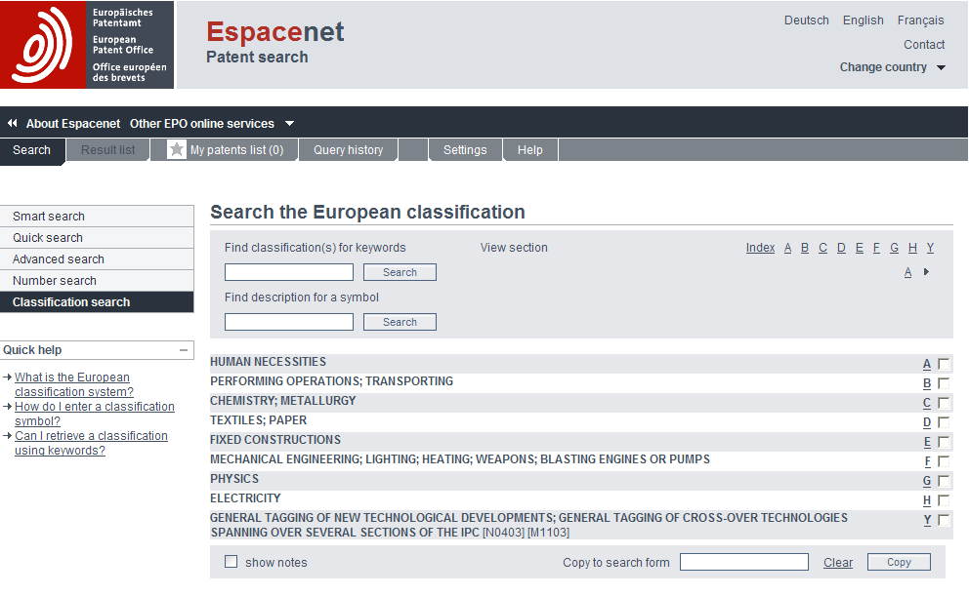
17
Website: http://worldwide.espacenet.com/eclasrch?locale=en_EP&classification=ecla
Notes:
17

Slide 18
Objectives
General features of Cooperative Patent Classification System (CPC)
Why the USPTO is pursuing this initiative
Draft CPC timeline
General look and feel of CPC
18
Notes:
18

Slide 19
Objectives
General features of Cooperative Patent Classification System (CPC)
Why the USPTO is pursuing this initiative
Draft CPC timeline
General look and feel of CPC
19
Notes:
19

Slide 20
Conclusion: Next Steps
Collaborate with POPA throughout the development and implementation phases
Provide opportunities for examiners to participate and share feedback
Develop CPC training
Finalize IT requirements to accommodate CPC
20
Notes:
20

Slide 21
Conclusion: CPC Resources
CPC General Website: http://www.CPCinfo.org
Link to Classification Homepage: http://ptoweb:8081/#a
Until CPC is available, ECLA searches can be conducted online using ESPACENET, the EPO’s public search tool:
http://worldwide.espacenet.com/
Look for EIC/STIC Demos on ESPACENET & ECLA
Feedback
Email: CPC@USPTO.gov
21
Notes:
21

Slide 22
Thank you!
22
Notes:
22

