Slide 1
REISSUES
BEST PRACTICES IN REISSUES
Pre & On/After September 16, 2012
Jean F Vollano
QAS 1600

Slide 2
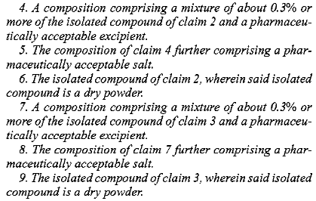
BEST PRACTICES IN REISSUE UNDERSTANDING CLAIM AMENDMENTS
A copy of a claim set from a patented reissue

Slide 3
AMENDMENTS TO CLAIMS
When amending reissue claims one uses markings in comparison with the existing patent claims each time there is an amendment.
One does not use the markings from the previous amendment.
The amendment must be made in accordance with 37 CFR 1.173.
Claims - An amendment paper must include the entire text of each claim being changed by such amendment paper and of each claim being added by such amendment paper. For any claim changed by the amendment paper, a parenthetical expression “amended, ” “twice amended, ” etc., should follow the claim number. Each changed patent claim and each added claim must include markings pursuant to paragraph (d) of this section, except that a patent claim or added claim should be canceled by a statement canceling the claim without presentation of the text of the claim.

Slide 4
AMENDMENTS TO THE CLAIMS
(d) Changes shown by markings . Any changes relative to the patent being reissued which are made to the specification, including the claims, upon filing, or by an amendment paper in the reissue
application, must include the following markings:
(1) The matter to be omitted by reissue must be enclosed in brackets; and
(2) The matter to be added by reissue must be underlined, except for amendments submitted on compact discs ( § § 1.96 and 1.821(c)). Matter added by reissue on compact discs must be
preceded with “ <U > ” and end with “ < /U > ” to properly identify the material being added.

Slide 5
AMENDMENT TO THE CLAIMS
Examples
Amendment to original issued claim:
1. (Original) A composition comprising acetylsalicylic acid, 95% ethanol and distilled water.
1. (Amended) A composition [comprising] consisting essentially of acetylsalicylic acid, 95% ethanol and distilled water.
Amendment to an amended claim.
1. (Twice Amended) A composition [comprising] consisting essentially of acetylsalicylic acid, 95% ethanol and [distilled] water.

Slide 6
AMENDMENTS TO THE CLAIMS
Examples (cont.)
5. (New) A composition of claim 1 which also includes a pharmaceutical carrier .
5. (New-amended) A composition of claim 1 which, besides including a pharmaceutical carrier, also includes an additional headache medicament besides acetylsalicylic acid.

Slide 7
AMENDMENT TO THE SPECIFICATION
(1) Specification other than the claims . Changes to the specification must be made by submission of the entire text of an added or rewritten paragraph, including markings pursuant to paragraph (d) of this section, except that an entire paragraph may be deleted by a statement deleting the paragraph without presentation of the text of the paragraph. The precise point in the specification must be identified where any added or rewritten paragraph is located. This paragraph applies whether the amendment is submitted on paper or compact disc (see § § 1.52(e)(1) and 1.821(c), but not for discs submitted under § 1.821(e)). ( Also 37 CFR 1.173)

Slide 8
AMENDMENT TO THE DRAWINGS
(3) Drawings. One or more patent drawings shall be amended in the following manner: Any changes to a patent drawing must be submitted as a replacement sheet of drawings which shall be an attachment to the amendment document. Any replacement sheet of drawings must be in compliance with § 1.84 and shall include all of the figures appearing on the original version of the sheet, even if only one figure is amended. Amended figures must be identified as “Amended, ” and any added figure must be identified as “New. ” In the event that a figure is canceled, the figure must be surrounded by brackets and identified as “Canceled. ” All changes to the drawing(s) shall be explained, in detail, beginning on a separate sheet accompanying the papers including the amendment to the drawings.
(i) A marked-up copy of any amended drawing figure, including annotations indicating the changes made, may be included. The marked-up copy must be clearly labeled as “Annotated Marked-up Drawings ” and must be presented in the amendment or remarks section that explains the change to the drawings.
(ii) A marked-up copy of any amended drawing figure, including annotations indicating
the changes made, must be provided when required by the examiner.
Notes:
Please note

Slide 9
CERTIFICATE OF CORRECTION
If a certificate of correction has been granted in the original patent then the certificate changes are considered part of the patent as issued.
As such the certificate changes must be made to the patent in the specification, abstract, or claims without underlining or bracketing ( See MPEP 1411.01 )
The examiner should make certain that all Certificate of Correction changes in the patent have been properly incorporated into the reissue application.

Slide 10
CERTIFICATE OF CORRECTION
If the changes are extensive a clean copy of the specification with the Certificate of Correction change maybe required by the examiner. For the clean copy of the specification to be entered. A petition must be filed under 37CFR 1.183 for waiver of 37 CFR 1.125(d) and 37 CFR 1.173(a)(1). The examiner’s requirement for the clean copy will generally serve as sufficient basis for granting the petition.
Note-Applicant is required to include a copy of any certificate of correction (37 CFR 1.322 – 1.324) issued in the patent for which the reissue is requested. (MPEP 1410 Content of reissue). Remember this submission does NOT take the place of the incorporation of the corrections into the specification etc

Slide 11
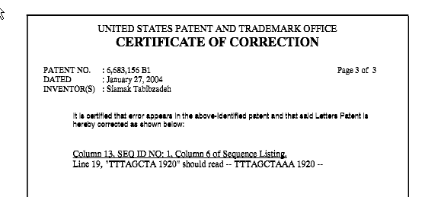
CERTIFICATE OF CORRECTION
Example
CTGGGCTTCA GCTCTAAGAA CTTCATTGCC CTGGGGATCA GACAGCCCCT ACCTACCC 1800
GCCCACTCCT CTGGAGACTG AGCCTTGCCC GTGCATATTT AGGTCATTTC CCACACTG 1860
TTAGAGAACT TGTCACCAGA AACCACATGT ATTTGCATGT TTTTTGTTAA TTTAGCTA 1920
GCAATTGAAT GTAGATACTC AGAAGAAATA AAAAATGATG TT 1962
Column 13 above has not been changed . It is not per certificate of correction.

Slide 12
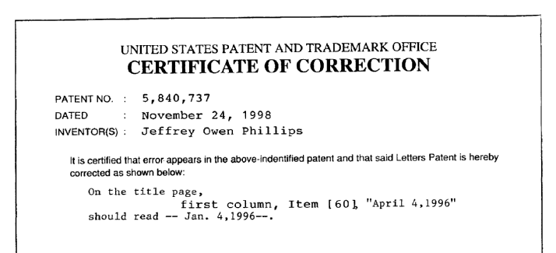
CERTIFICATE OF CORRECTION
The following is on the title page as submitted:
Thus the title page has not been filed as issued so a change has to be made after submission.
One could state- On the title page, please delete Item [60] and replace it, per the certificate of correction, with the following.
[60] Provisional application No. 60/009,608, Jan. 4, 1996.
Note - there is no underlining or bracketing since it is NOT an amendment

Slide 13
REISSUES and the Leahy-Smith America Invents Act
Changes to Implement the Inventor’s Oath final rules published August14, 2012:
The final rule revises reissue rules 1.172 and 1.175 effective for any reissue filed on or after September 16, 2012.
For any reissue filed before September 16, 2012 the reissue rules for 1.172 and 1.175 are pre AIA
The AIA and pre AIA rules for the various reissue oaths and other forms will be discussed.

Slide 14
AIA APPLICANT
Applicants may be the inventors
Applicants may be persons (§1.42(b), 1.46): To whom the inventor has assigned;
To whom the inventor is under an obligation to assign; and
Who otherwise show sufficient proprietary interest in the matter.
Notes:
Petition 182 in old days.

Slide 15
OATH/DECLARATION
Reissue oath must contain a SPECIFIC error and an error upon which the reissue can be based.
Not all errors can be corrected under reissue practice( e.g. no recapture) See MPEP 1402 for what may constitute the “error” required by 35 USC 251.
For the specific error in the claims - It is not sufficient for an oath /declaration to merely state “this application is being filed to correct errors in the patent which may be noted from the changes made in the disclosure. ” Rather, the oath /declaration must specifically identify an error. In addition, it is not sufficient to merely reproduce the claims with brackets and underlining and state that such will identify the error.

Slide 16
OATH/DECLARATION
Two types of first or full oath in reissue ( if reissue is filed before 9/16/12)
INVENTOR OATH- PTO/SB/51 (05-08)
ASSIGNEE OATH – PTO/SB/52 (05-08)
Inventor oath must be used for broadening reissue
Assignee oath can be used for narrowing reissue or reissue not broadening the claims (e.g. inventorship change)
If Reissue is filed on or after 9/16/12 Two types of oath
INVENTOR OATH - PTO/AIA/05(06-12)
ASSIGNEE OATH – PTO/AIA/06(06-12)
SUBSTITUTE STATEMENT- PTO/AIA/07 (06-12)

Slide 17
OATH AIA changes September 16, 2012
Note-Sept 16, 2012 per AIA some of the oath requirements 1.63 &1.175 have changed.
- Duty to disclose under 1.56 is eliminated from the oath - foreign priority has been removed from the oath .
- The 35 USC 251 statute no longer has a requirement of “without deceptive intent” statement.
- the willful or false statement made is modified to read … is punishable under 18 U.S.C. 1001 by fine or imprisonment of not more than (5) years or both.
- “made or authorized to be made” statement is required by statute not rule changes
Notes:
Continuation declaration. Must put in new form to meet the current requirements.

Slide 18
Oath PTO/AIA/05(06-12) Inventor Oath
● I believe, I am the original inventor or joint inventor... “First” dropped.
● Foreign priority – Removed -ADS now used for Priority
● Duty to disclosed removed from oath- however the duty still remains☺ .
● Without deceptive intent- Removed
● … any willful or false statement made… is punishable under 18 U.S.C. 1001 by fine or imprisonment of not more than (5) years or both – Emphasized
● Error section (partly or wholly inoperative or invalid, etc) –stays
● Citizenship - Removed
Power of attorney section – Stays Don’t forget to fill out the PTO/SB/81 to appoint attn. or the PTO/AIA/80 or 81
Then at the bottom of the oath ( signature)
Legal name of sole or first inventor, Inventor's Signature, Date(Optional),Residence.
Footnote -Additional joint inventors are named on the ____ ( no. of pages) of supplemental sheet(s) PTO/AIA/10 attached hereto.

Slide 19
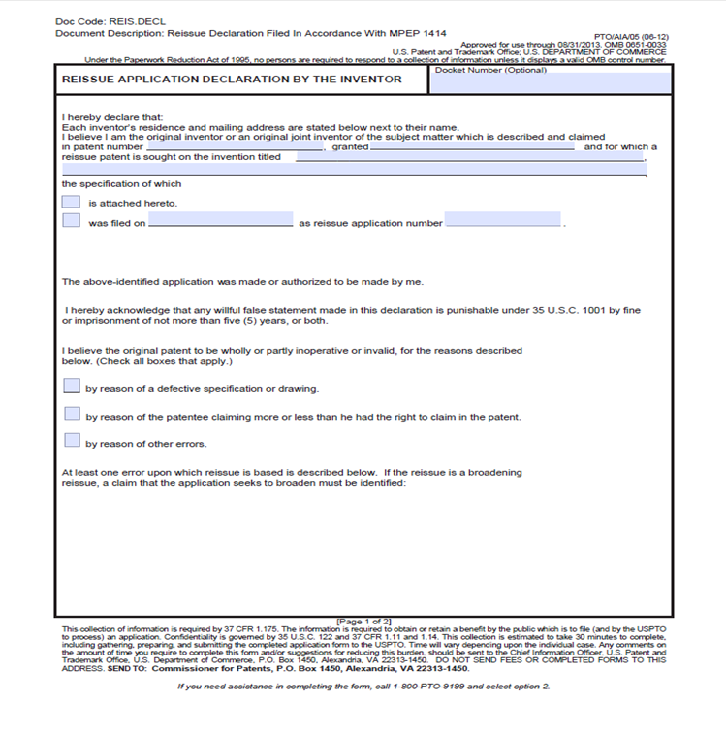

Slide 20
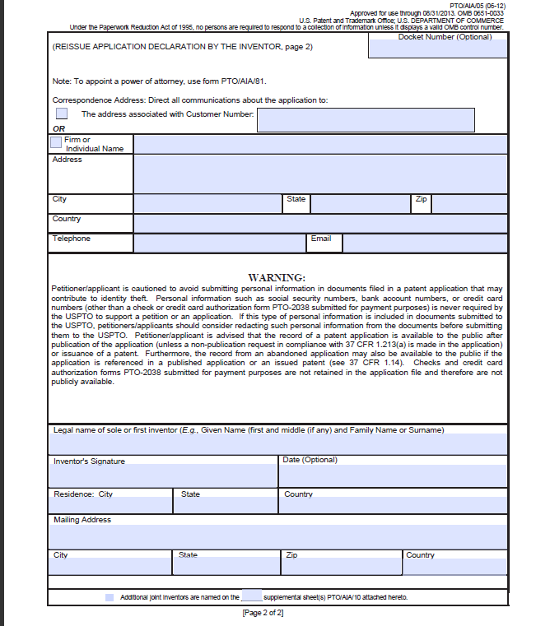
Notes:
Check PTO/SB/81

Slide 21
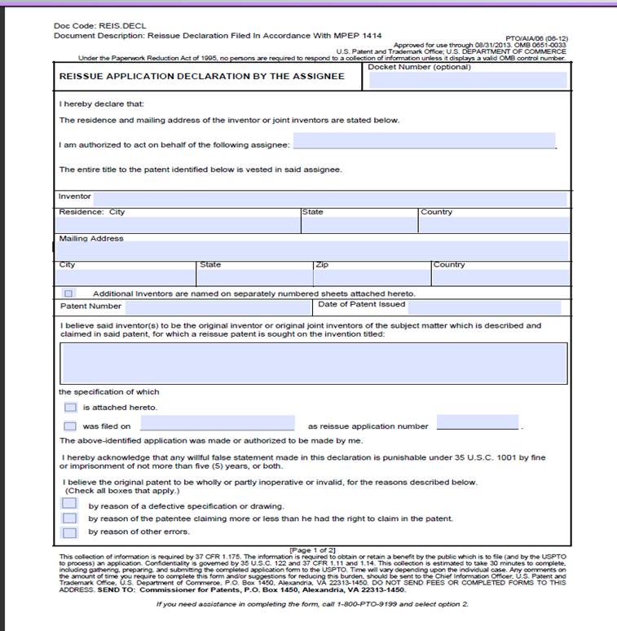

Slide 22
Oath PTO/AIA/06(06-12) Assignee Oath
The “title of my position with said assignee” is - Removed
● This application for the original patent was filed under 37 CFR 1.46 by the assignee of the entire interest –(Under these circumstances, don’t need inventor involved to apply for a reissues.) Added
● The rest of the additions and removals that appear on the inventor oath and the assignee oath are the same.
Note: Under the AIA there is NO necessity to have a
“SUPPLEMENTAL OATH” at time of allowance
The removal of “without deceptive intent” from 35 USC 251 eliminates the need for supplemental oaths.
● A new oath or declaration would still be required where there is a failure to: identify a specific and/or reissuable error

Slide 23
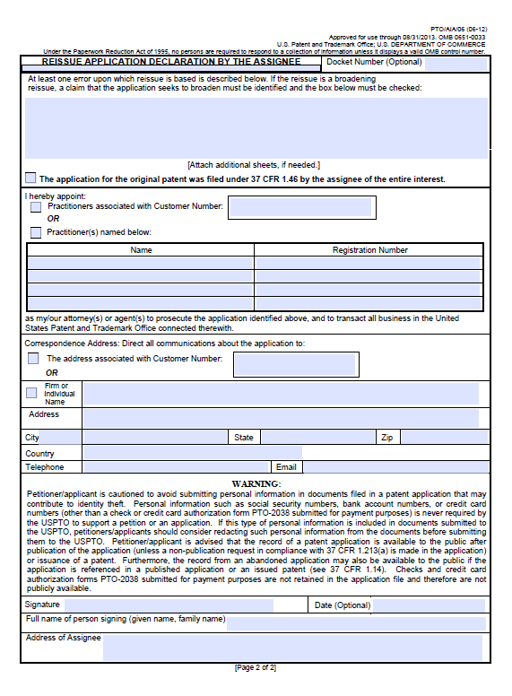

Slide 24
Reissue Oath Who May Sign under AIA
Reissue oath/dec may be signed by the
Sole or joint inventors (AIA/05)
Assignee applicant:
where the reissue is not a broadening reissue (AIA/06)
OR
where the application for the original patent was filed under 37CFR 1.46 by assignee of the entire interest(1.175(c) (2)).

Slide 25
Substitute Statement in Lieu of Oath PTO/AIA/07 ( who may sign)
Non-inventor applicant may file a 37 CFR 1.64 substitute statement in lieu of reissue oath or declaration for an inventor X, if inventor X:
is deceased; is legally incapacitated;
cannot be found or reached after diligent effort;
or refuses to execute an oath or declaration.
No need to provide old §1.47 type (or any) evidence.
Substitute Statement In Lieu Of An Oath Or Declaration For Reissue Patent Application, PTO/AIA/07 Note: Although you need not provide the proof to the PTO, it would be wise to retain the proof for your records

Slide 26
Reissue Oath: Continuing Reissue(1.175(f)(1))(AIA)
A copy of an oath/dec( filed on or after 9/16/12) from a prior reissue application is permitted if any of the following three conditions exist:
1) The oath/dec for the earlier-filed reissue application was executed by the entirety of the inventorship entity;
2) The continuating reissue application does not seek to enlarge the scope OR
3) The application for the original patent was filed under 1.46 by the assignee of the entire interest.
Note- Even if a copy is permitted, there still needs to be a new oath/dec filed for any added inventor

Slide 27
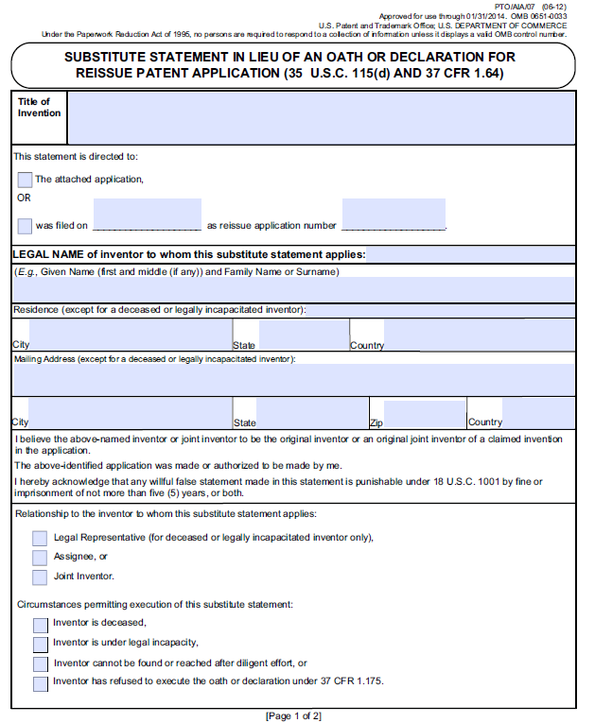

Slide 28
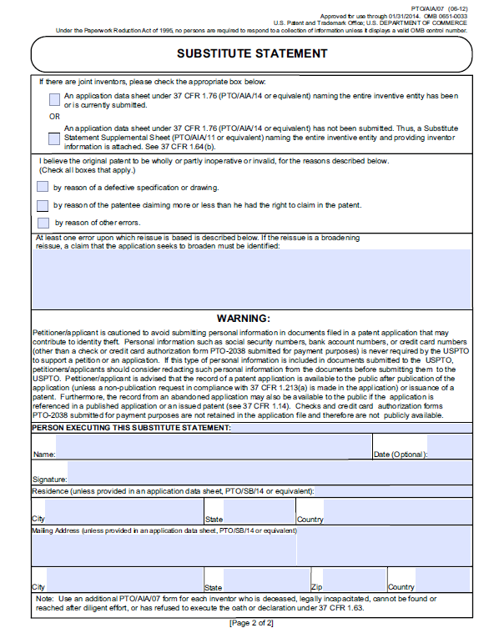

Slide 29
Application Data Sheet ADS/filed with Utility and Reissue Oath (on/after 9/16/2012 )
Application Data Sheet (ADS) must be filed:
1. To identify applicants who are not the inventor(s).
2. To set the inventorship where an inventor’s oath or declaration is not being presented. This permits postponing the declaration until the payment of the issue fee. ( NOT allowed in reissues) 1.175(e)
3. To set the inventorship where there are joint inventors and each joint inventor is executing a declaration that only names that inventor and not all of the inventors.
4. To make benefit claims under 37 CFR 1.78 foreign and/or domestic priority claims under 37 CFR 1.55 (except applications entering the national stage under 35 U.S.C. 371).
Notes:
If assigned need ADS.

Slide 30
OATH/DECLARATION
“Any error in the claims must be identified by reference to the specific claim(s) and the specific claim language wherein lies the error. A statement of " … failure to include a claim directed to …" and then presenting a newly added claim, would not be considered a sufficient " error" statement because applicant has not pointed out what the other claims lacked that the newly added claim has, or vice versa. Such a statement would be no better than saying in the reissue oath or declaration that " this application is being filed to correct errors in the patent which may be noted from the change made by adding new claim 10." In both cases, the error has not been identified.” (See MPEP 1414)

Slide 31
OATH/DECLARATION
“Likewise, a statement of the error as " … the inclusion of claims 3-5 which were unduly broad …" and then canceling claims 3-5, would not be considered a sufficient error statement because applicant has not pointed out what the canceled claims lacked that the remaining claims contain. The statement of what the remaining claims contain need not identify specific limitations, but rather may provide a general identification, such as " Claims 3-5 did not provide for any of the tracking mechanisms of claims 6-12, nor did they provide an attachment mechanism such as those in claims1-2 and 9-16." “

Slide 32
OATH/DECLARATION
EXAMPLE OF NON SPECIFIC ERROR- The patent claims more than applicant had a right to claim in view of U.S. Patent No. 2,222,222.
EXAMPLE OF SPECIFIC ERROR- The patent claims more than applicant had a right to claim In view of U.S. Patent No. 2,222,222 which describes a plant having integrated into its genome a DNA construct containing a delta-five desaturase, wherein the plant reportedly produces dodecaenoic acid See, U.S. Patent 2,222,222, Example 12. Claim1 of the patent is amended in this reissue application to exclude that subject matter of the 2,222,222 patent.

Slide 33
OATH/DECLARATION
Other errors that can be grounds for a reissue include,
change of inventorship, failure to file a certified copy of the original foreign application to obtain the right of foreign priority, a substantive drawing error, a substantive specification error, failure to adequately claim benefit under 35 USC 120 in earlier filed copending US patent application, and correction of problem with patent oath.
Example non specific error – The inventorship is being changed
Example of specific error- The inventorship is being change to include two additional inventors, John Smith and Jane Doe.

Slide 34
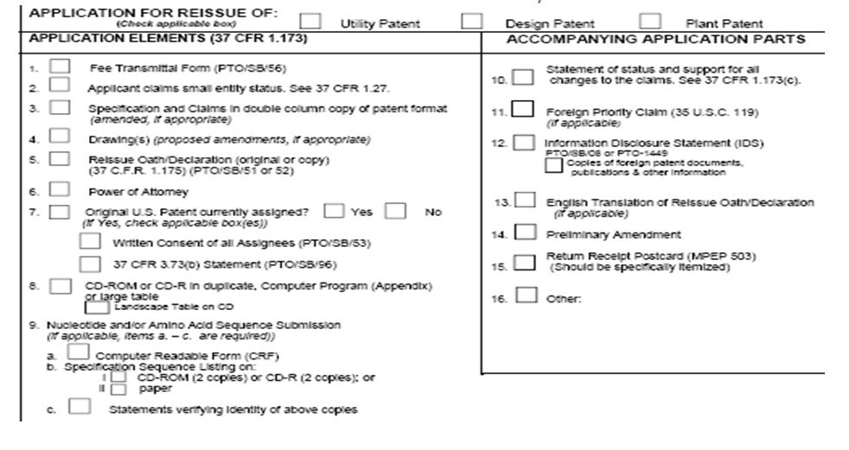
Transmittal Form PTO/SB/53
Applicant can check the “NO” box of item 7 of Form PTO/SB/50 (08-08) if there is no assignee (REISSUE PATENT APPLICATION TRANSMITTAL)

Slide 35
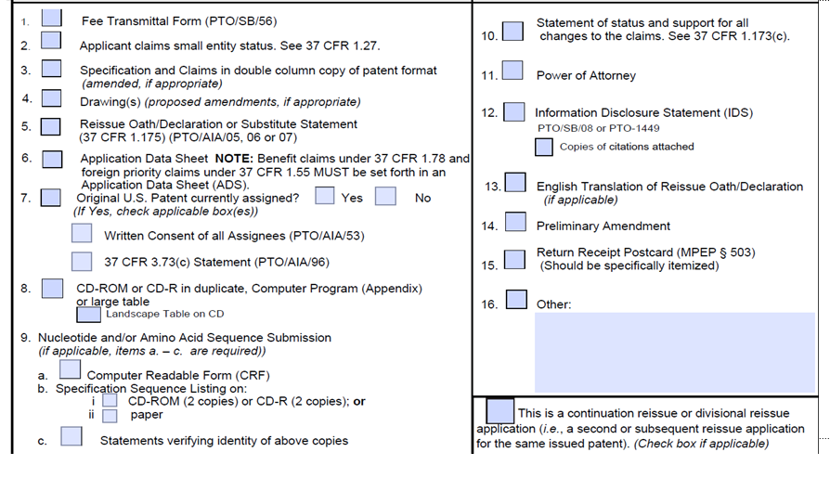
NEW TRANSMITTAL FORM PTO/AIA/50(07-12) Consent box still there
Note: 5. for PTO/A1A/05,06,07 6. requirement of ADS for benefit claims under 37 CFR 1.78 and foreign under 37 CFR 1.55 Box at right hand corner to remove question of Bauman type filing.

Slide 36
CONSENT PTO/SB/53 pre AIA
IF there are multiple assignees that own part of the patent then consents from each assignee are required (e.g. ABC corporation and XYZ corporation). Note the pre AIA consent refers to 3.73(b) to show ownership. Title is also required in the PTO/AIA/consent form
Often overlooked on the consent form is the typed or printed name and the TITLE of the person signing for the assignee see partial form below. Same requirement for title found on the PTO/AIA/53.

Slide 37
CONSENT
Where a continuation reissue application is filed with a copy of the assignee consent from the parent reissue application, and the parent reissue application is not to be abandoned, the copy of the consent should not be accepted.
In a voluntary divisional reissue a copy of the consent from the parent reissue application should not be accepted whether or not the parent reissue is to be abandoned.
In a divisional reissue based on a restriction made in the parent reissue application , the assignee need not file a consent because the consent has already been provided in the parent reissue. MPEP 1410.01

Slide 38
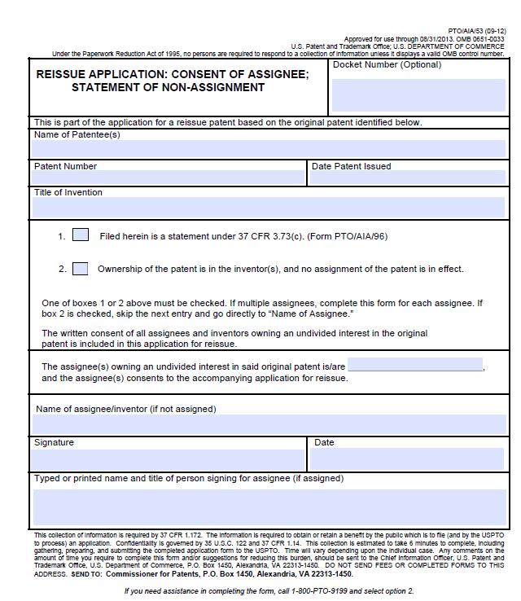
CONSENT PTO/AIA/53( note 3.73(c) for ownership)

Slide 39
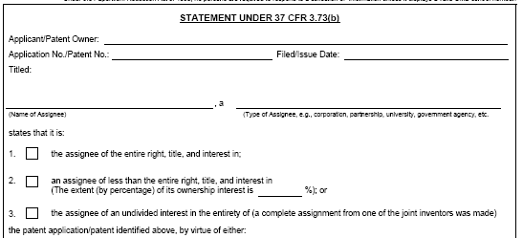
OWNERSHIP/ASSIGNEE
In PTO/SB/96 applicant must state he is either the assignee of the entire interest or an assignee of less than the entire right, title… and then give the percentage of ownership or state entire interest of one of the inventors( see boxes 1-3 below). Note this if not using a PTO form.

Slide 40
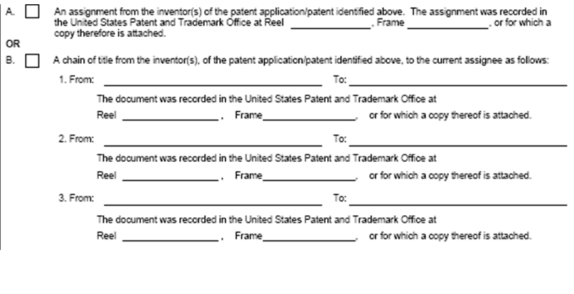
OWNERSHIP/ASSIGNEE
This is the second part of the PTO/SB/96 which shows the assignment section.

Slide 41
OWNERSHIP/ ASSIGNEE
If one makes a statement that they are authorized act on behalf of the
assignee the office will accept such statement absent evidence in the it
record that cast doubt on the authorization. “On the PTO/SB/96 form
“ The undersigned( whose title is supplied below)is authorized to act on behalf of the assignee.” – note this is pre 9/16/2012.
MPEP 324 does permit a copy of the 3.73 (b) statement to be filed (in a continuation or divisional even when they are filed on/after 9/16/12), but if it’s a brand new application or a newly filed 3.73 statement, it should identify the correct rule under which it is filed which is 3.73(c).

Slide 42
Ownership PTO/AIA/96 Statement under 37 CFR 3.73(c)
As for a practitioner signing:
3.73(b) Statements (SB/96): practitioners could/can sign if they had/have the authority to act on behalf of the assignee. This is not the same thing as having POA-it’s binding authority like an officer of the company would have, usually given by corporate resolution from a board of directors. See MPEP 324, Section V for a blurb about this.
3.73(c) Statements (AIA/96): For applications filed on or after 9/16/12, 3.73(d)(3) provides that a practitioner of record can sign the statement. IF the 3.73(c) comes in with a POA that appoints that practitioner, we’ll consider the practitioner to be “of record” for purposes of the signature on the 3.73(c). Otherwise the practitioner would need to already be of record to sign the statement.

Slide 43
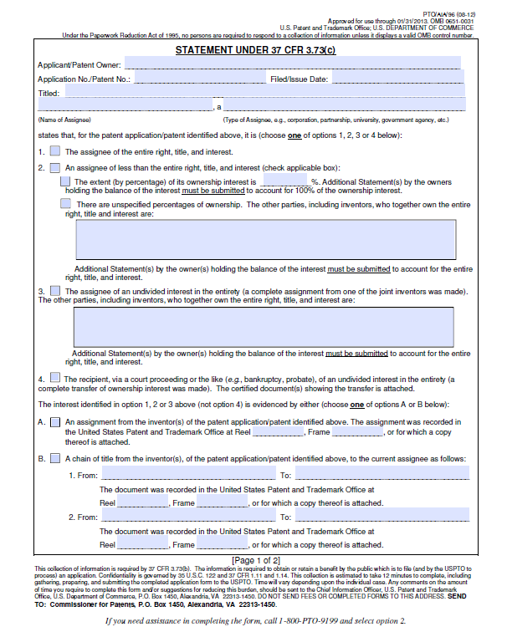
ED

Slide 44
OWNERSHIP/ASSIGNEE

Slide 45
OWNERSHIP/ASSIGNEE
MPEP 324 (V) PARTY WHO MUST SIGN
(A) The submission may be signed by a person in the organization having apparent authority to sign on behalf of the organization. 37 CFR 3.73(b)(2)(ii). An officer (chief executive officer, president, vice-president, secretary, or treasurer) is presumed to have authority to sign on behalf of the organization. The signature of the chairman of the board of directors is acceptable, but not the signature of an individual director. Modifications of these basic titles are accept ­able, such as vice-president for sales, executive vice-president, assistant treasurer, vice-chairman of the board of directors. In foreign countries, a person who holds the title “Manager ” or “Director ” is normally an officer and is presumed to have the authority to sign on behalf of the organization.

Slide 46
OWNERSHIP/ASSIGNEE
PARTY WHO MUST SIGN ( continued)
(B) The submission may be signed by any person, if the submission sets forth that the person signing is authorized (or empowered) to act on behalf of the assignee, i.e. ,to sign the submission on behalf of the assignee. 37 CFR 3.73(b)(2)(i).
(C) The submission may be signed by a person empowered by an organizational resolution (e.g., corporate resolution, partnership resolution) to sign the submission on behalf of the assignee, if a copy of the resolution is, or was previously, submitted in the record.
Where a submission does not comply with (A), (B), or (C) above, evidence of the person’s authority to sign will be required. Attorney of record in itself is not sufficient to allow the attorney to sign the 3.73(b)or consent.

Slide 47
OWNERSHIP/ ASSIGNEE (AIA)
Party who must sign. The submission establishing ownership by the assignee must be signed by a party who is authorized to act on behalf of the assignee
OR
A patent practitioner of record.

Slide 48
SEQUENCE COMPLIANCE
SEQUENCE ID DATA DOES NOT AUTOMATICALLY TRANSFER IN A REISSUE FROM THE ORIGINAL PATENT
A reissue application that contains sequences must comply with the sequence rules (37 CFR 1.821-1.825) like any other application. This may be accomplished by filing a new sequence listing via a new diskette plus paper copy plus statement that the diskette and the paper copy are the same or via three copies of a CD plus statement or via EFS (no paper copy of statement required). Compliance may also be accomplished by requesting transfer of the sequence listing from the patented file with a paper copy plus statement accompanying the transfer request.

Slide 49
ACCESSING THE PTO FORMS REISSUE QAS TC1600
Use website www.uspto.gov for PTO forms
REISSUE/REEXAM HELP LINE 571-272-7703
JEAN F. VOLLANO QAS 571-272-0648 - General questions on content and procedures
BENNETT CELSA QAS 571-272-0807 - Recapture and Broadening
PINCHUS LAUFER OPLA Lead of Reissues 571-272-7726

